Slide 1
Steve Kirsch Founder
Vaccine Safety Research Foundation October 15, 2022
What the data tells us
Notes:
TODO
Add my prion article
Bad cat on FRED + amd’s article: 1.8M disabled were added to the rolls. That’s a direct count. VAERS shows 14,181 ⇒ 126 URF for disabled which is in line with our 41 minimum for SAEs. Death / Disability ratio in VAERS is
If alive after a year, out of woods.
Bob + looney article

Slide 2
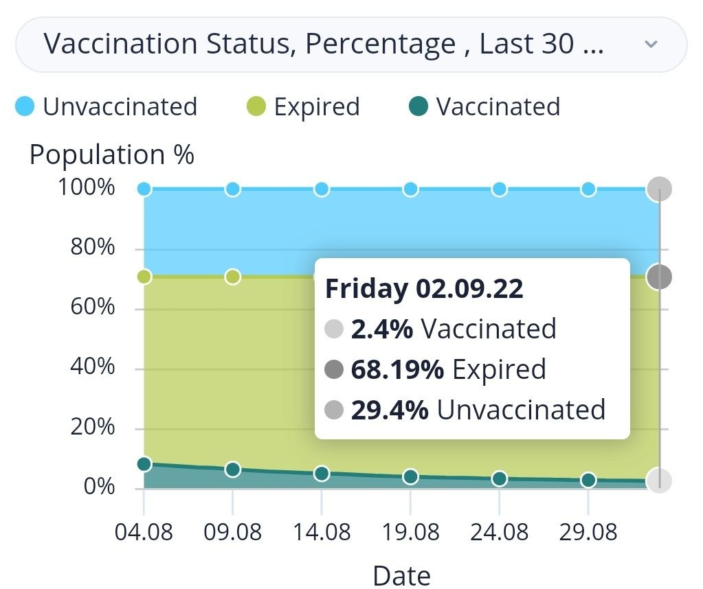
Israel (Sept 2, 2022)
This is stunning since people in Israel normally do whatever the government tells them.

Slide 3
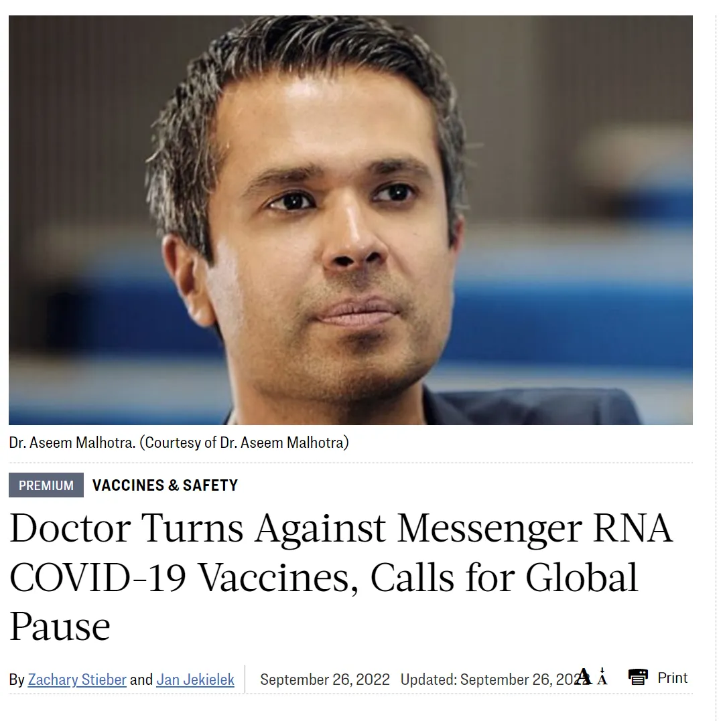
UK cardiologist Aseem Malhotra
Pro → Con
(Sept 25 2022)

Slide 4
Why?

Slide 5
If you are open to questioning what you were told and look at the data yourself, “unexplainable” → easily explained

Slide 6
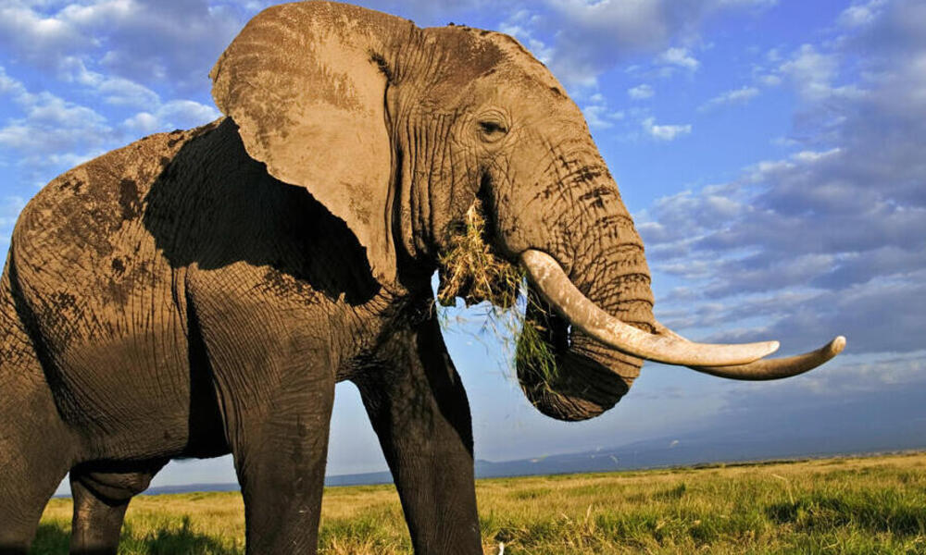
Is the cure worse than the disease?

Slide 7
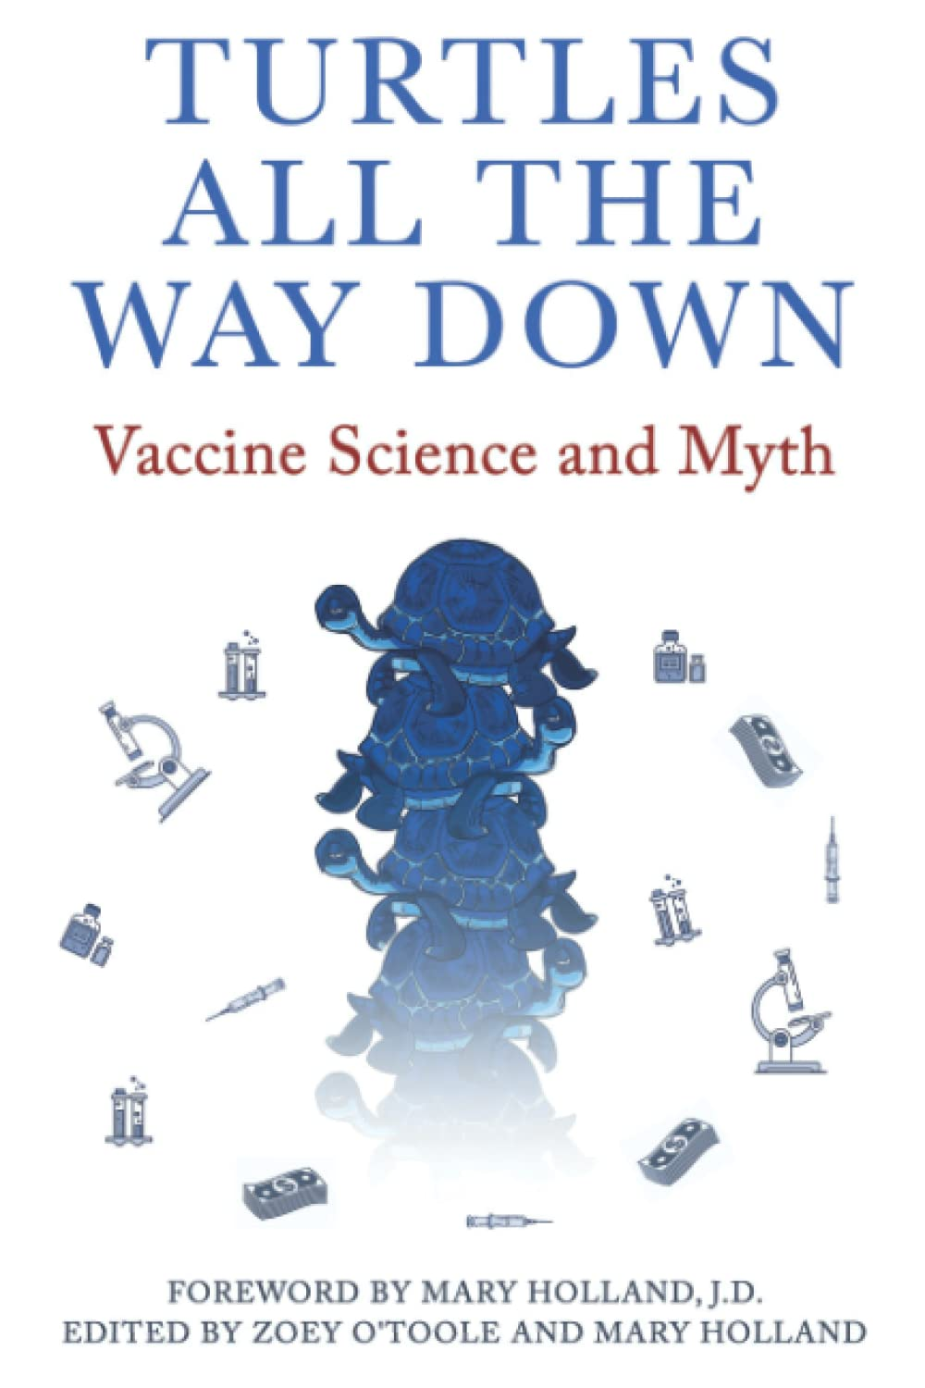
You don’t have to believe me…
Verify yourself
Or read this book

Slide 8
My injury rate estimates (per 250M vaccinated)
AE | # | Source
Injured | 20M | 7.7% had to seek medical attention (v-safe/ICAN).
Disabled | 2M | FRED database
Life threatening injury | 1M | Physician estimates (personal communication)
Killed | 500K | VAERS, polls, surveys (1, 2)
Saved | <11K | Pfizer Phase 3 trial results
Notes:
7,7% had to seek medical care according to the V-safe data so that’s the injury rate. Neurology practice had 5% rate in neuro alone.
Disabled is based on FRED data
Life threatening injury is based on physician estimates of .5% of their patient base.
Died is based on 2 per thousand based on physician observations in large practices, VAERS data, user polling data…, died suddenly group size.
Saved is based on 1 life saved for 22,000 vaccinated per the Pfizer Phase 3 trial
The Pfizer Phase 3 data showed 1 COVID life was saved per 22,000 vaccinated. Mathew Crawford estimated the death rate is 411 deaths per million doses. The table assumes people got 2 doses. See also Estimating the number of deaths in America.

Slide 9
Killed > Saved for all ages
The VAERS numbers are calculated based on the assumption that the vaccine are perfect and prevent all COVID deaths.
# killed per person saved
Age | VAERS | UK ONS
20-30 | 6.1 | 16.9
30-40 | 3.9 | 4.8
40-50 | 2.8 | 4.8
50-60 | 2.4 | 3.4
60-70 | 2.3 | 2.9
70-80 | 1.9 | 1.6
80+ | 1.8 | n/a
Notes:
The table shows the Killed by vaccine:Saved from COVID death in 6 months numbers. Units for both columns are per million doses.

Slide 10
I made the following claims on Fox News on Aug 10, 2022: Hundreds of thousands killed
Millions vax injured
Most dangerous vax of all time
Fox said that they couldn’t verify my statements, and never asked for the data! I posted data supporting my statements. My key statements were later independently verified.

Slide 11
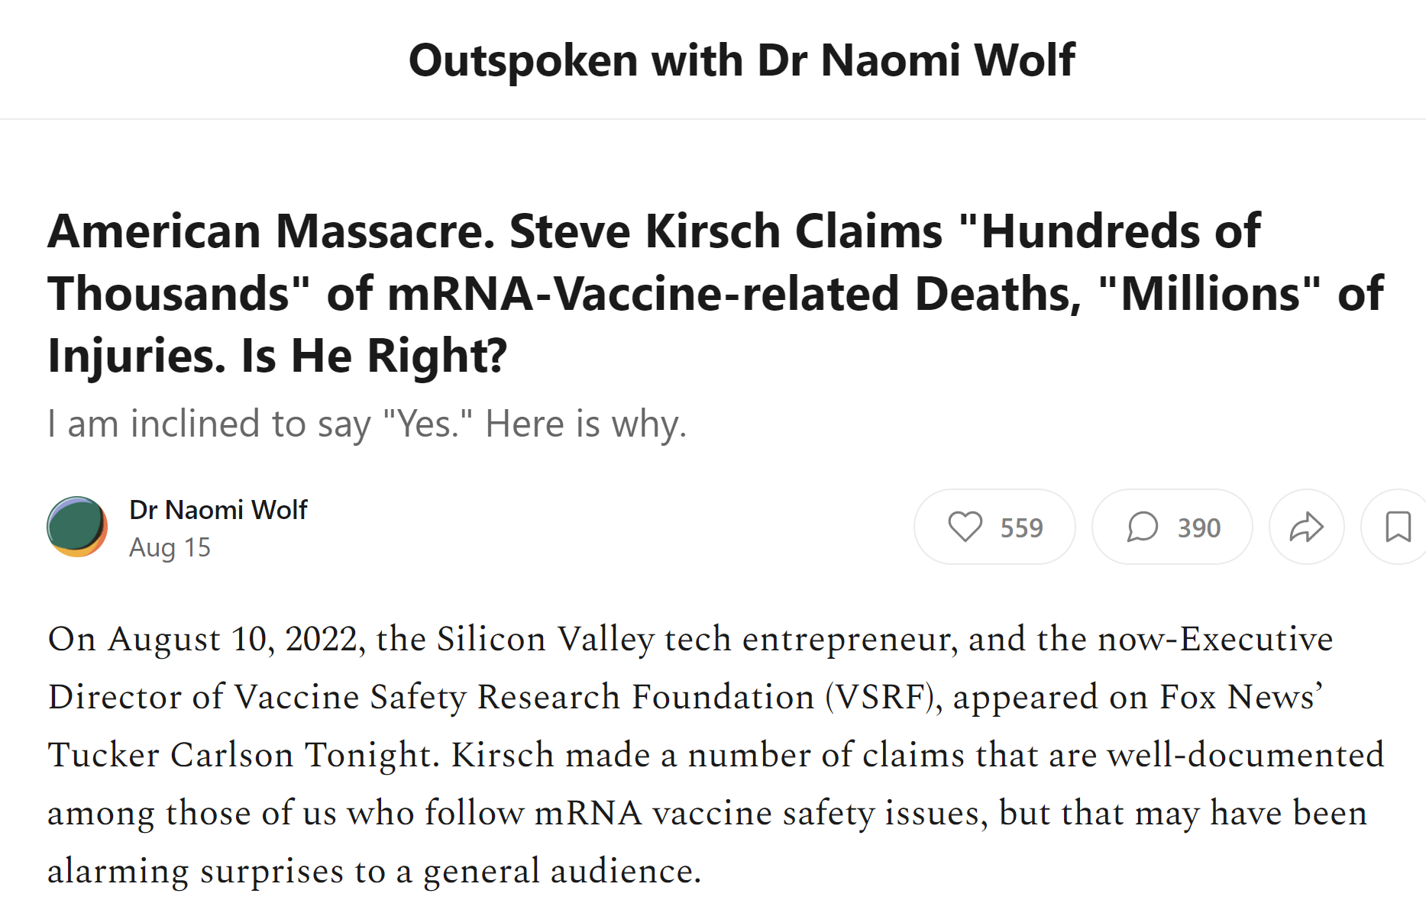
Dr. Naomi Wolf independently validated my claims using her own methods
(nobody else wanted to see the data)

Slide 12
The elephant in the room
The vaccines have killed more people than COVID
501 people survey Jul 2, 2022
373 vaccinated.
38 killed/500=7.6% of households → 7M people
→ 2.8% death rate of 250M vaxxed
Notes:
Pollfish survey

Slide 13
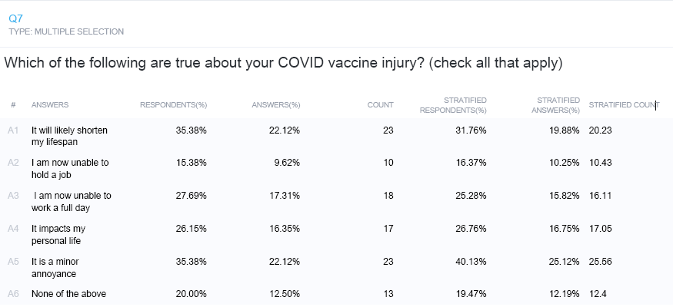
2.7% of vaccinated report that they are “now unable to hold a job.” That’s >7M people disabled.
Notes:
There were 500 people who took the survey. 380 of the 500 were vaccinated. 10.43/380 = 2.7%

Slide 14
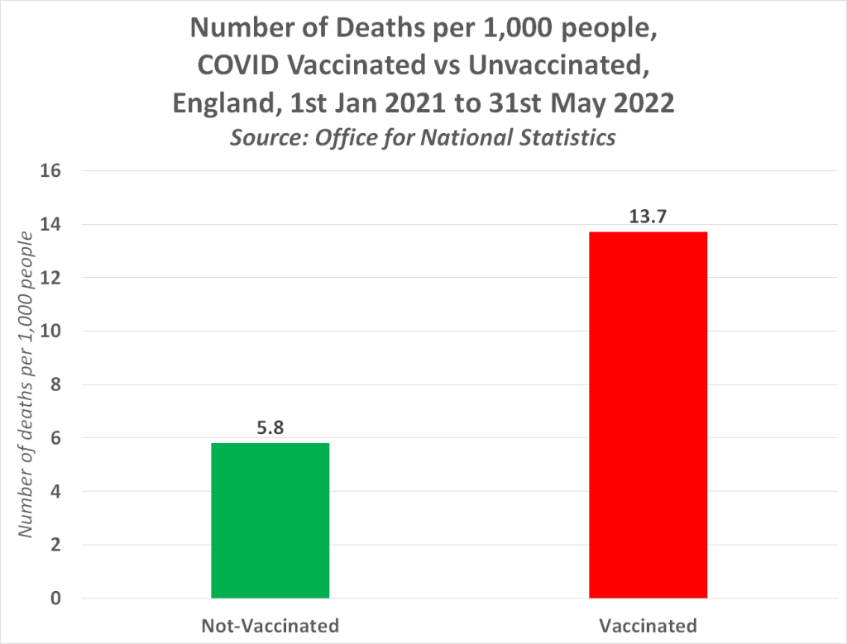

Slide 15
Is there a benefit?
Expert report prepared for the Liberal Party of Canada (Trudeau’s party) looked at Ontario data.
No benefits:
Infection
Hospitalization
Death

Slide 16
Is there a benefit?
The Classen paper analyzed the clinical trial data for all three US vaccines and confirmed the lack of any overall benefit. There was an increase in morbidity which was highly statistically significant in all three vaccines.
Morbidity ↑
All-cause mortality: No benefit (it was negative in the Pfizer study, but not statistically significant)

Slide 17
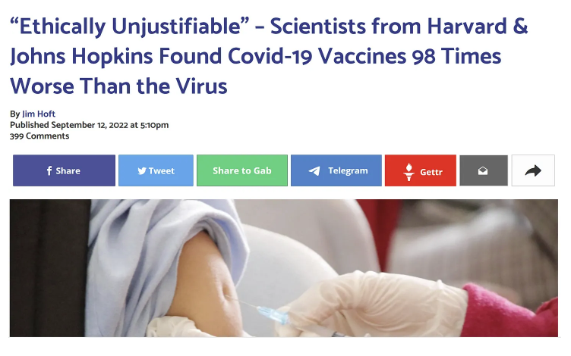
Is there a benefit?

Slide 18
Methods used for estimating the numbers
Government databases (VAERS, worldwide stats, Social security death master file)
Polls
Insurance company data
Embalmer reports
Physician anecdotes that cannot be explained
Extreme personal anecdotes (Wayne Root, podiatrist)
All of these methods produce data consistent with the “very unsafe” hypothesis

Slide 19
The CDC’s own safety signal triggered for “death” but they never noticed.

Slide 20
Are people looking the other way?
ACIP chair doesn’t want to see the Israeli safety data
Florida is the only state to look for safety signals
Only in Thailand do they look at blood before v. after
Maddie de Garay injury was never investigated
4X cardiac deaths in the Pfizer Phase 3 trial vax group
Vaccine injury reports (10% have 30 or more symptoms), but NIH can’t figure out if there is an association after >1 year of looking at the problem
Stanford pediatrician sees the harm but is told to stay silent because there is “insufficient evidence of causality” (precautionary principle is ignored).

Slide 21
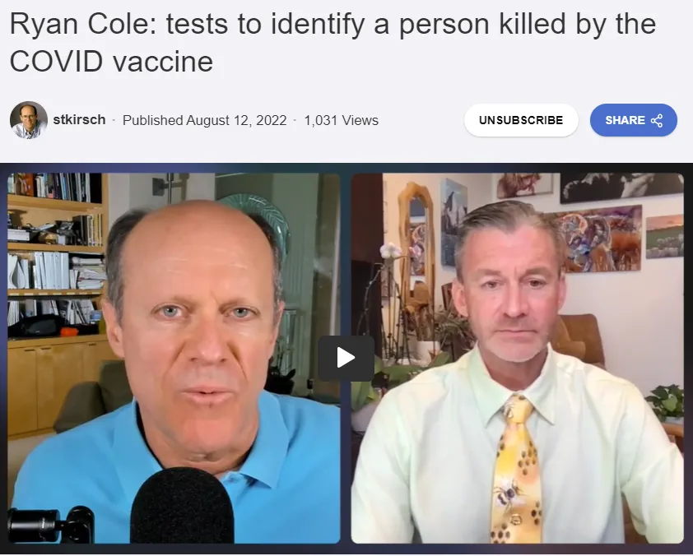
The CDC has never told medical examiners to run the specialized tests that are required to identify the vaccine as a possible cause.

Slide 22
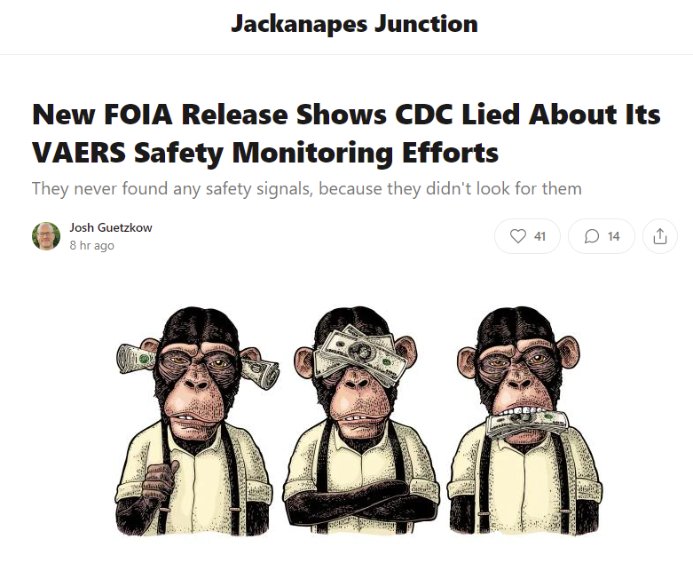
Notes:
David Wiseman slide deck

Slide 23
Why didn’t anyone ask any questions about the gaming in the Phase 3 trial?!? This is very unlikely to happen by chance (p.< 0.00001).
Notes:
This is from page 18 of the December 10, 2020 VRBPAC meeting document:

Slide 24
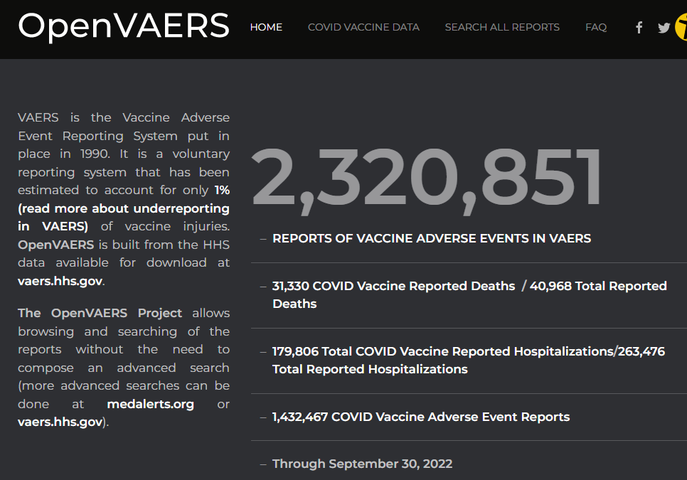

Slide 25
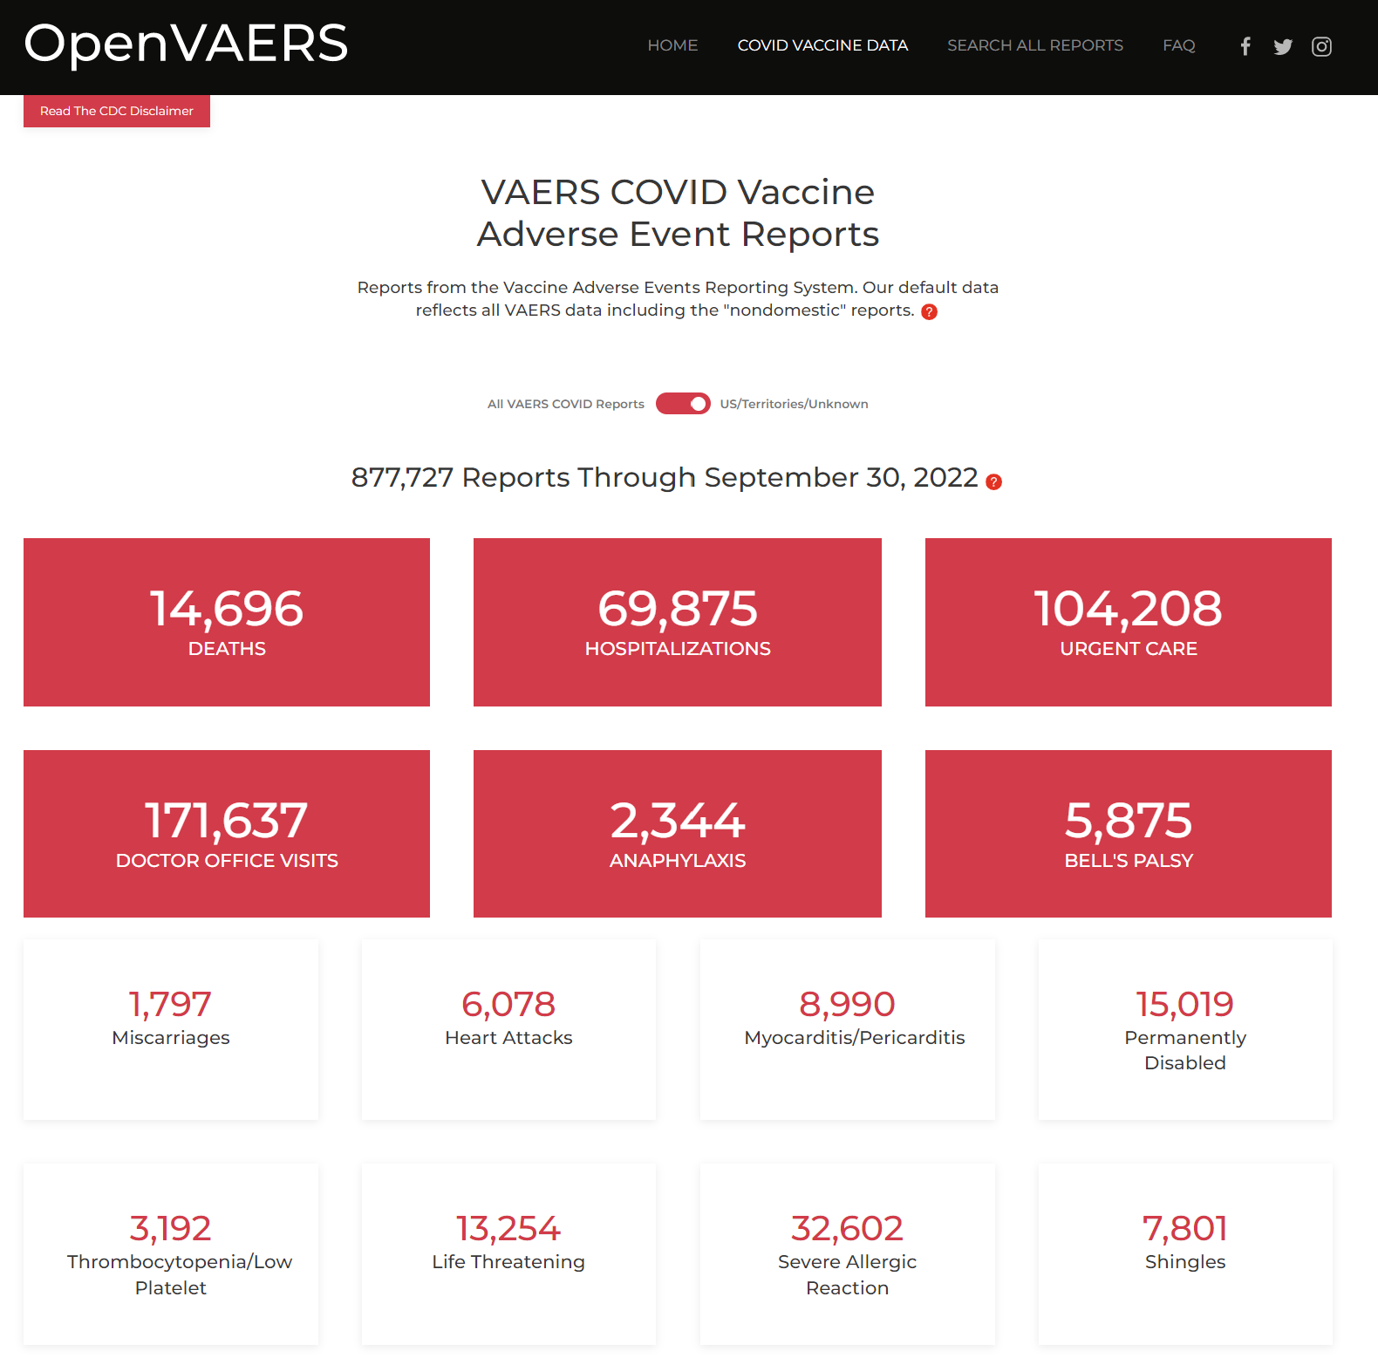
US data switch

Slide 26
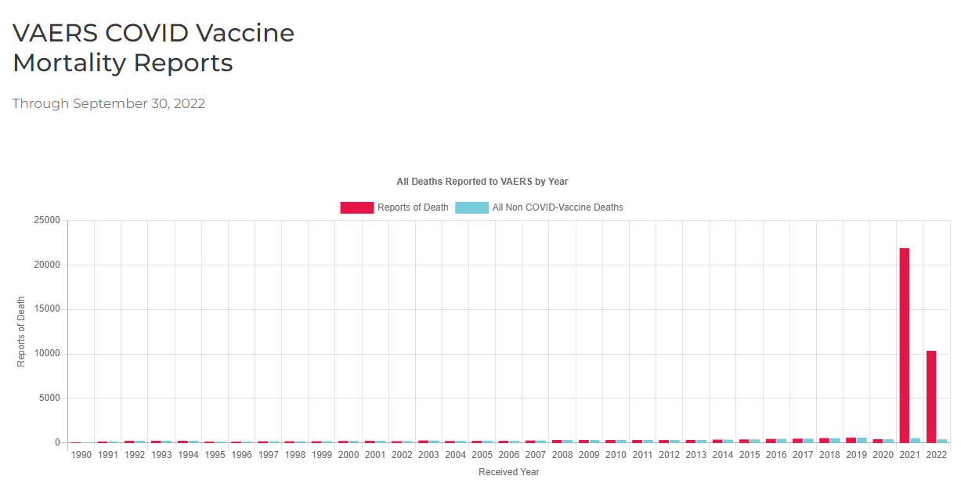
How can this happen?
Notes:
From OpenVAERS Mortality reports page

Slide 27
Massive fraud/gaming
Massive overreporting all of a sudden for just the COVID vaccines worldwide in every adverse event tracking system
The deadliest vaccine in history
Hint: There is only evidence for #3 (and it’s overwhelming)
Notes:
From OpenVAERS Mortality reports page

Slide 28
VAERS UnderReporting Factor (URF)
# anaphylaxis cases
URF*# anaphylaxis reports
=
# shots in study
# shots given
Clinical study (reference)
VAERS
Example using anaphylaxis as the reference since it should always be reported and is obvious so gives the lowest possible estimate (most conservative). For other conditions, the URF will be higher.
Notes:
VAERS is used whenever it supports the narrative
Gaslighting doesn’t work. They are camera shy.
Propensity to report is same. Docs seeing more events.
OK, then what *did* kill these people?

Slide 29
URF estimates range from 30 to 50
Using anaphylaxis —> 41
This is a minimum; the rate for all other events such as death is higher
Anaphylaxis is the best case (serious, required, obvious, temporal)
We know the COVID vaccines kill people up to 1 year later and those deaths are unlikely to be reported to VAERS since autopsies using proper staining are almost never done to associate the death to the vax. Most of COVID vaccine deaths looks like “bad luck.”
Because doctors are told the vaccines are safe, they are less likely to report a death to VAERS vs. if they are told the opposite.
Notes:
VAERS is used whenever it supports the narrative
Gaslighting doesn’t work. They are camera shy.
Propensity to report is same. Docs seeing more events.
OK, then what *did* kill these people?

Slide 30
The CDC refuses to calculate a URF estimate
When reporting to ACIP, the CDC has never mentioned adjusting the VAERS data with the URF.
My calculation was meticulously done here: Estimating the number of COVID vaccine deaths in America. It uses the methodology described in this paper by 5 CDC authors.
Notes:
VAERS is used whenever it supports the narrative
Gaslighting doesn’t work. They are camera shy.
Propensity to report is same. Docs seeing more events.
OK, then what *did* kill these people?

Slide 31
Gardasil: Ignoring the URF and safety signals
From Turtles (the Slade 2009 report in Chapter 3, p. 100)...
2006: FDA approved. Serious issues began surfacing linked temporally.
2009: The CDC starts investigation! It concluded the safety profile was generally consistent with other vaccines even though the authors acknowledged that the VAERS reporting rate for Gardasil was “triple that of all other vaccines combined.” They attributed the higher reporting rate to greater public attention (without evidence). Does this sound familiar?
2011: 120 countries approved Gardasil.
Today, >10 years later, nobody is the wiser.
Notes:
VAERS is used whenever it supports the narrative
Gaslighting doesn’t work. They are camera shy.
Propensity to report is same. Docs seeing more events.
OK, then what *did* kill these people?

Slide 32
VAERS: Estimating the number dead
Over 13,972 deaths in US reported
Subtract 1,000 for “background deaths”
12,972 “excess” deaths
Assume 10% were COVID deaths
11,674 * 41 = 478K unexplained excess deaths
This is conservative. 41 is URF for anaphylaxis per JAMA paper. Anaphylaxis is “best case reporting.”
Methodology described here; based on CDC paper.
Other URF values: 31 (Rose), 50 (Siri), …
Notes:
VAERS is used whenever it supports the narrative
Gaslighting doesn’t work. They are camera shy.
Propensity to report is same. Docs seeing more events.
OK, then what *did* kill these people?

Slide 33
Attacks vs. Explanations
“Dumpster diving” VAERS is used whenever it supports the narrative
You don’t know how to interpret it Gaslighting doesn’t work. They are camera shy.
It’s just over-reporting Propensity to report is same. Docs seeing more events.
Correlation isn’t causation
Really? Then what killed these people?
Notes:
VAERS is used whenever it supports the narrative
Gaslighting doesn’t work. They are camera shy.
Propensity to report is same. Docs seeing more events.
OK, then what *did* kill these people?

Slide 34
It’s not “over reporting.” It’s “more events.”
Small practice
750 patients Reports in 29 years: 0 Reports this year: 25
Large neuro practice
20,000 patients Reports in 11 years: 0 Reports this year: 1,000

Slide 35
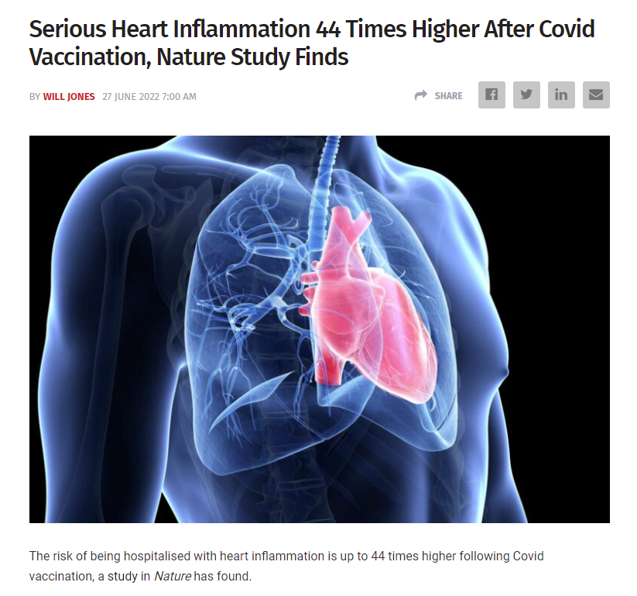
Is this what they mean by a “slightly elevated” risk of myocarditis?
44X higher in the week following injection.

Slide 36
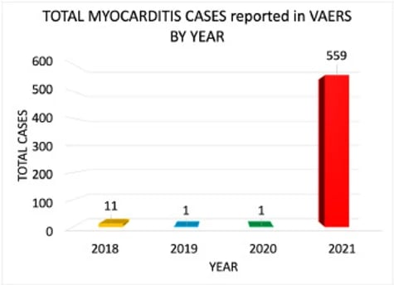
Is this what they mean by a “slightly elevated” risk of myocarditis?
The medical community didn’t say a word when the publisher unilaterally WITHDREW the paper with NO REASON.
From the Rose paper that was published in Current Problems in Cardiology which publisher unethically censored. Do see now why it was censored? You can read the full paper here.

Slide 37
1 in 317 boys (16-17) will get myocarditis from the vaccine
(in order to save ~1 in a million kids from dying from COVID)
Note: Two dose calc: 1000000/((5.2+71.5)*41)=317 (note 41 is the URF even though the FDA and CDC refuse to calculate the value). See calculation here.
Reference: John Su, Safety update for COVID-19 vaccines: VAERS
Notes:
1

Slide 38
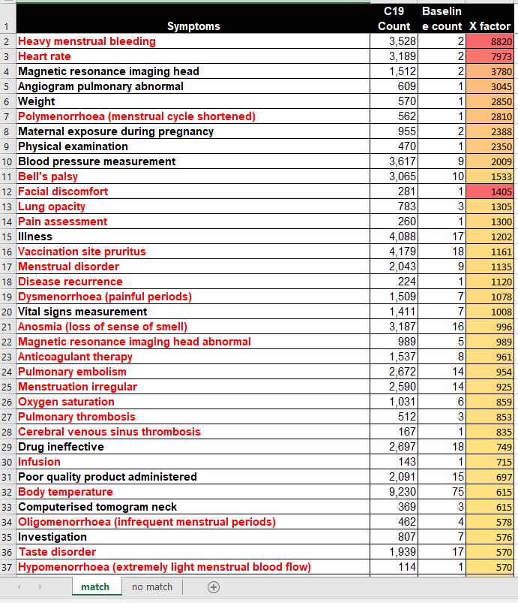
Menstrual issues are highly elevated by up to 8,800X.
How did they miss this?

Slide 39
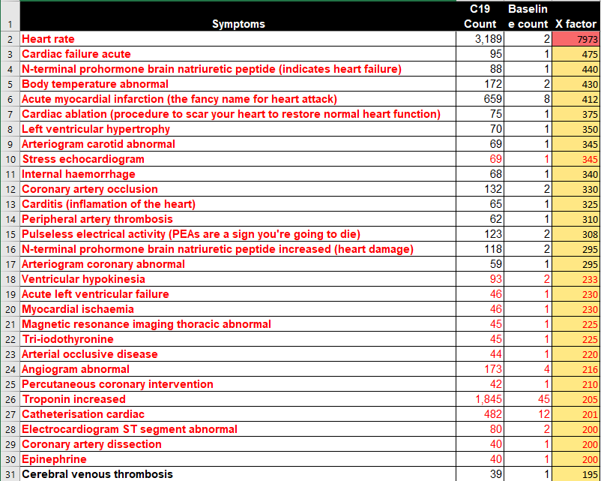
Acute cardiac failure elevated by 475X

Slide 40
What does the VAERS data show?
Are there more adverse events reported this year than all events ever combined (70+ vaccines, >30 years)? | Yes
Can you determine causality via Bradford-Hill? | Yes. Dose and temporal signals.
What is the underreporting factor (URF)? | 41 calculated per CDC methodology
Any chance that this is just “over reporting?” | No. Physician surveys show unprecedented # of events. Fingerprint is different.
How many Americans have died from these vaccines? | > 250K
How many Americans have been permanently disabled from these vaccines? | 2M
How many kids 5-11 will we sacrifice for every kid saved? | 117

Slide 41
What does the VAERS data show?
Is the only serious side effect myocarditis? | No. There are hundreds that are elevated.
What are the four biggest categories? | Reproductive (esp female), immunological, cardiovascular, neurological.
Top causes of death? | Cardiac arrest, PE, intracranial hemorrhage.’
Are the vaccines suitable some ages such as old w/comorbidities? | No. Kill > Saved.
Were any of the deaths in VAERS for kids 12-17 ever explained? | No
Is this the most dangerous vaccine ever invented? | Yes. >800X more deadly than smallpox.

Slide 42
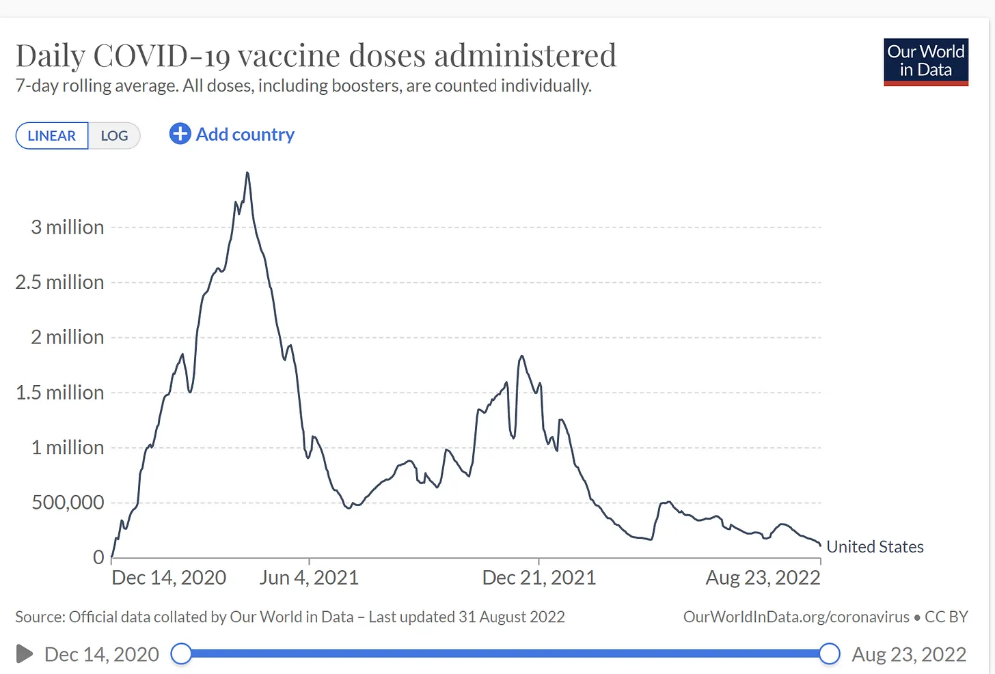
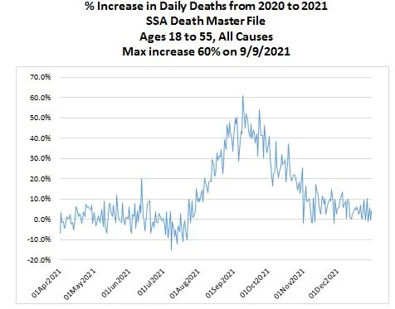
5 month delay in death peak after vaccination
(same delay as observed by embalmers and insurance companies)

Slide 43
My estimated mortality profile from the COVID vaccine that is consistent with the observations of embalmers, insurance companies, doctors, Florida, … Source
Inflammation deaths
Clot-related deaths
1 year

Slide 44
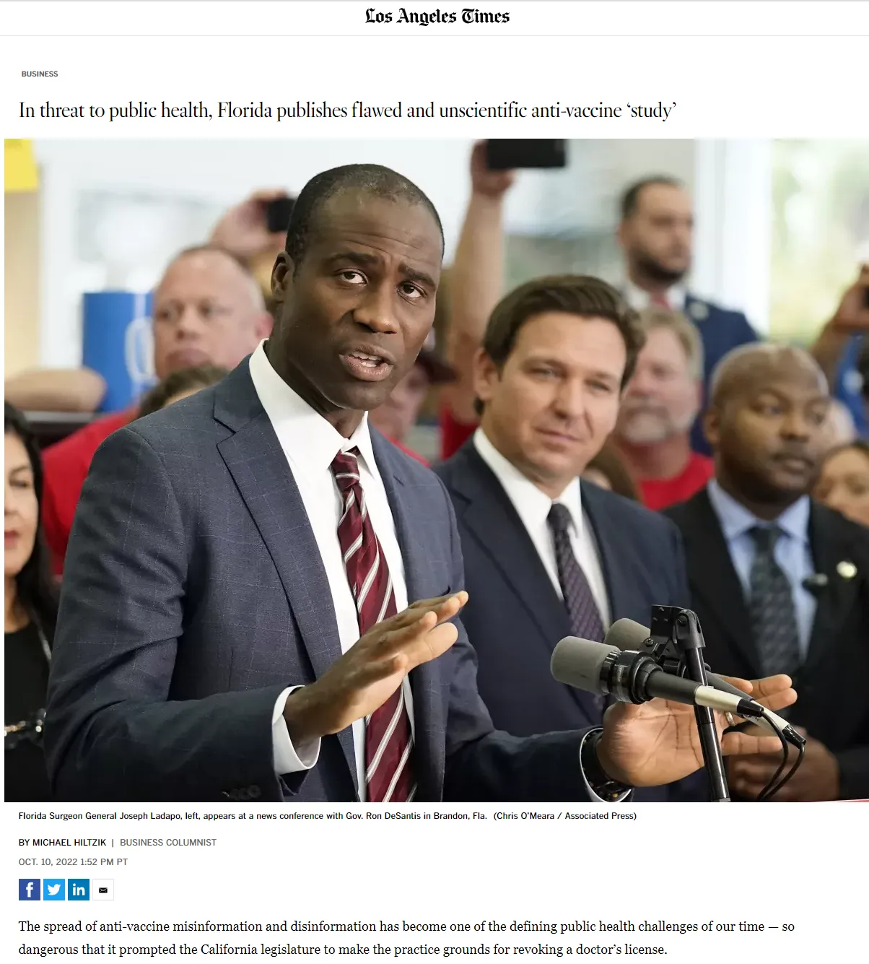
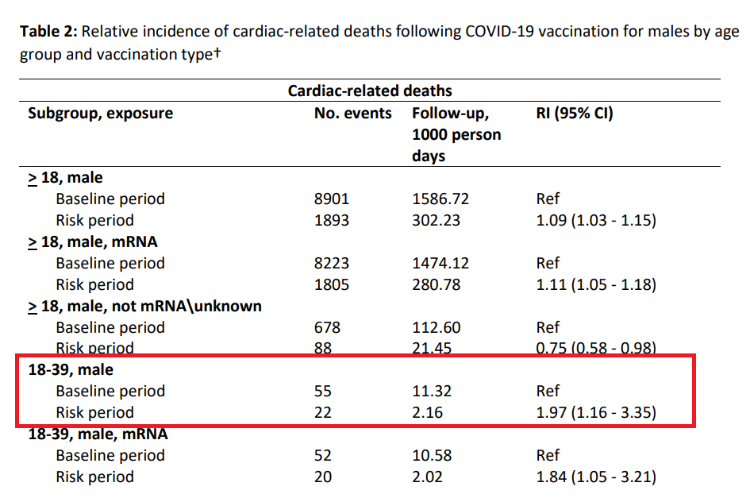
The study in Florida underestimated the increase in death because it was a SCCS with a 28 day cutoff.

Slide 45
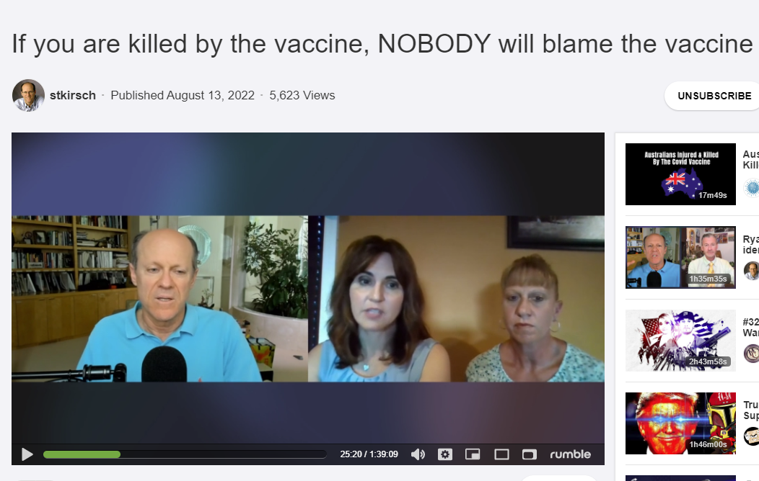
“Pandemic of the unvaccinated?”
Why were ICUs filled with the vaccinated?
You are considered unvaxxed until 2 weeks after your second shot.
If you don’t have a vaccine card, you can be considered unvaccinated.
If the vaccine kills you 5 months later, few will figure it out. Even if you died the next day, many doctors won’t make the association.

Slide 46
New Mexico death report study found only 1/6 COVID deaths were consistent with COVID symptoms.
1M deaths → 166K
Notes:
Personal communication

Slide 47
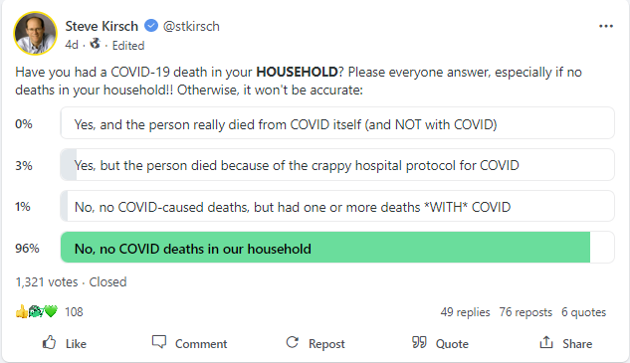
Most COVID deaths are believed to be caused by hospital protocols

Slide 48
Wayne Allyn Root’s wedding
8 months post-wedding
 | Unvax | Vax
N | 100 | 100
Serious injuries | 0 | 26
Deaths | 0 | 7
Notes:
Wayne could be unlucky. Maybe 100% were vaccinated! Maybe he got an “unlucky” Poisson distribution. So divide by 8 to be conservative. 1% avg death rate for ages 30-60. This would be 75M vaxxed * 1% = 750,000 people killed by the vax

Slide 49
Survey of my followers 631 responses
 | Unvax | Vax
N | 1000 | 1000
Serious injuries | 8 | 211
Deaths | 2 | 47
See my survey for details. The excess death rate is 4.7-.2=4.5% due to the vaccine. Here is the poll that was used. Poll asked for # of events since Jan 2021.

Slide 50
Excess injury/death rates of vaxxed vs. unvaxxed
 | Wayne Root | My followers | Pollfish
N (total) | 200 | 8,000 | 500
Excess injuries | 26% | 20% | 9%
Excess deaths | 8% | 4.5% | 2.8%
Pollfish numbers are low since the 75% of the respondents are vaccinated who are unlikely to think any deaths are vax related.

Slide 51
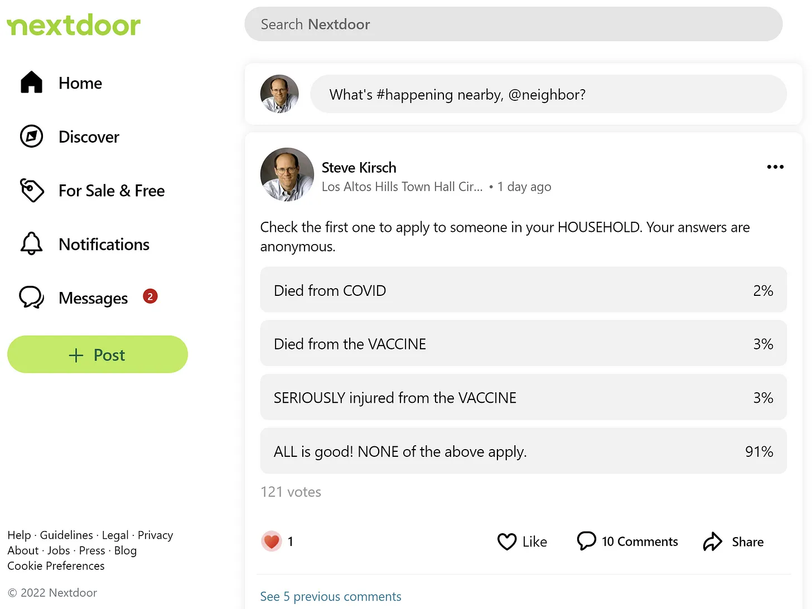

Slide 52
Early treatment has always been the superior approach to treating COVID
The Fareed & Tyson early treatment protocol has 0 hospitalization and fatality when given early (over 10,000 patients treated) w/virtually no long-haul COVID. Nobody in the government wanted to verify the stats.
COVID has an overall Case Fatality Rate (CFR) of 0.2% overall. Kids have a 1,000 lower risk of death than people over 70. Why do we have a one-size-fits-all approach? It’s nonsensical.

Slide 53
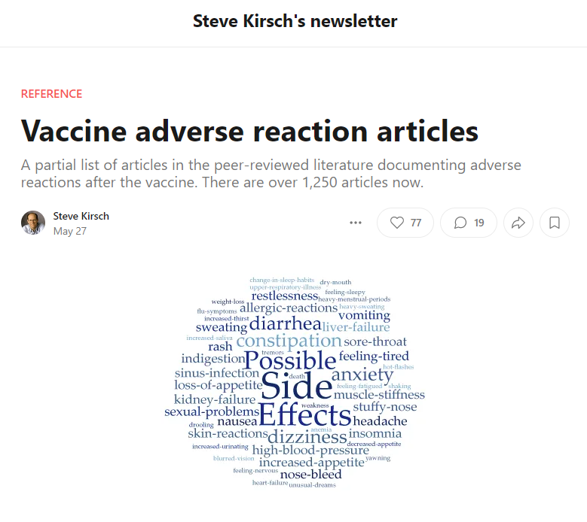
Today, there are over 2,000 articles in scientific journals showing harm

Slide 54
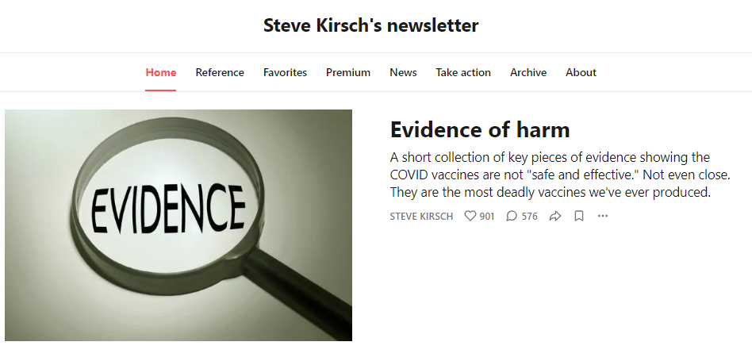
For more info

